Slide 1
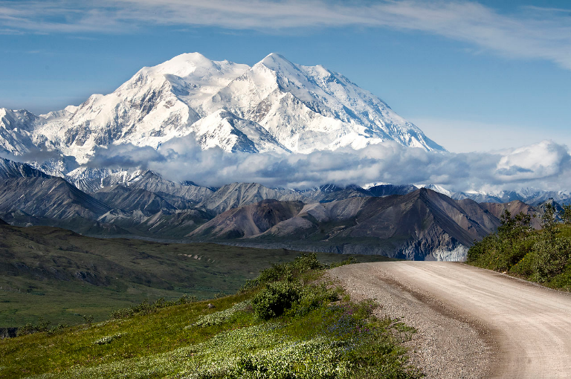

Lecture #3: A brief history of Denali National Park
and mountaineering in the park
IMG-Denali
Guide Orientation and Information
March 2019
Dr. Daniel Mann
Department of Geosciences
University of Alaska
Fairbanks
99775
dhmann@alaska.edu

Slide 2
Denali National Park includes the
National Park,
within which is the
Denali Wilderness and the Denali National Preserve.
(Adjacent to the National Park’s southeast corner is Denali State Park.)
D
US National Park Service

Slide 3
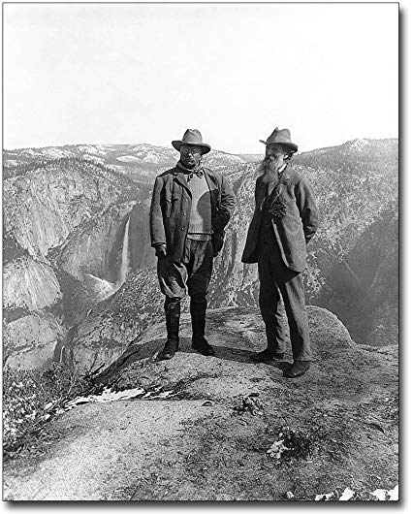
"We have fallen heirs to the most glorious heritage a people ever received, and each one must do his part if we wish to show that the nation is worthy of its good fortune." Theodore Roosevelt
Teddy Roosevelt and John Muir on Glacier Point, Yosemite Valley, California. PHOTOGRAPHER / CREDIT: Underwood & Underwood, 1906

Slide 4
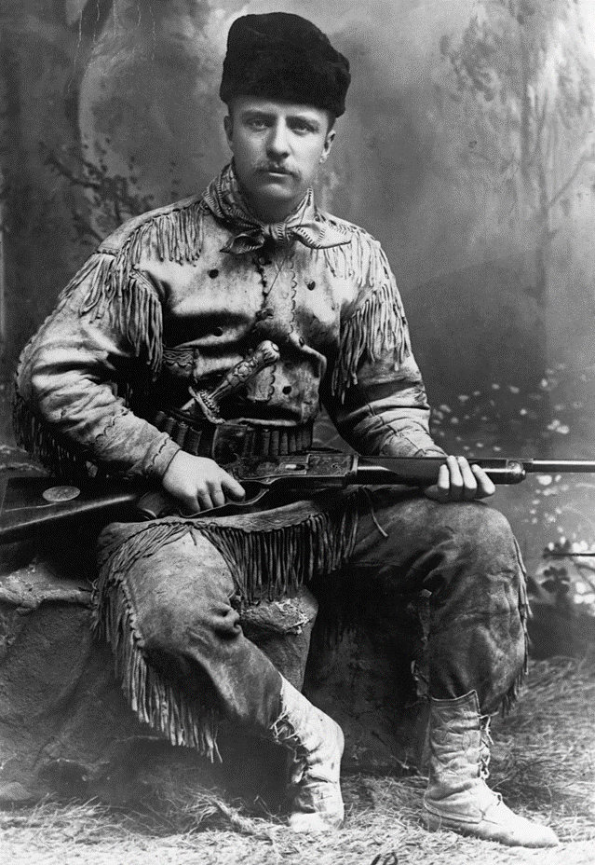
After his mother and first wife died on the same day, in the same house, in 1884, Roosevelt bought a ranch in South Dakota.
He became a lifelong advocate of the "strenuous life."
The young Teddy Roosevelt
Photographed by George Grantham Baine in 1885 in New York City. Public Domain

Slide 5
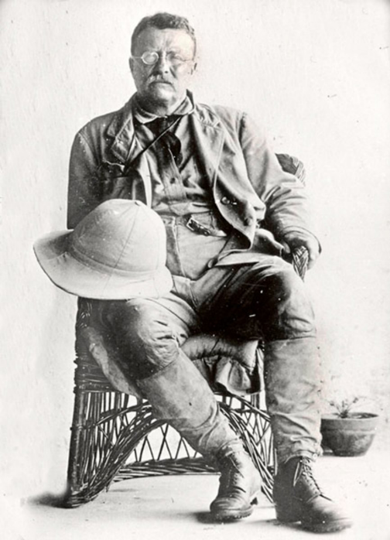
During his presidency (1901 to 1909), Roosevelt established 150 national forests, 51 bird reserves, four national game preserves, five national parks, and 18 national monuments.
Theodore Roosevelt dressed in expedition attire. ca. 1909 Public domain photo.

Slide 6
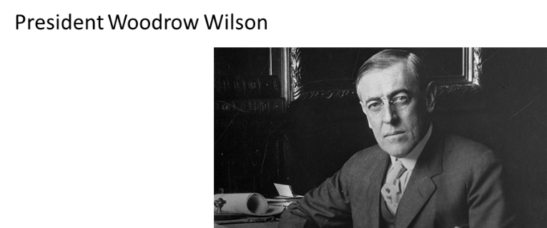
National Park Service Organic Act
The federal law that established the US National Park Service in 1916.
Signed into law by Woodrow Wilson.

Slide 7
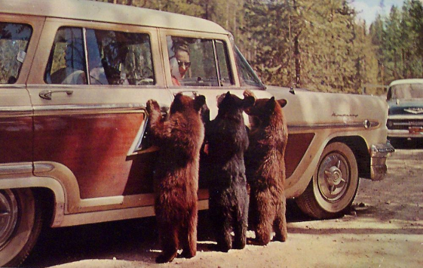
US National Park Service’s dual mission:
preserving the ecological and historical integrity of the places entrusted to its management
making them available and accessible for public use and enjoyment.
Yellowstone NP ca. 1960

Slide 8
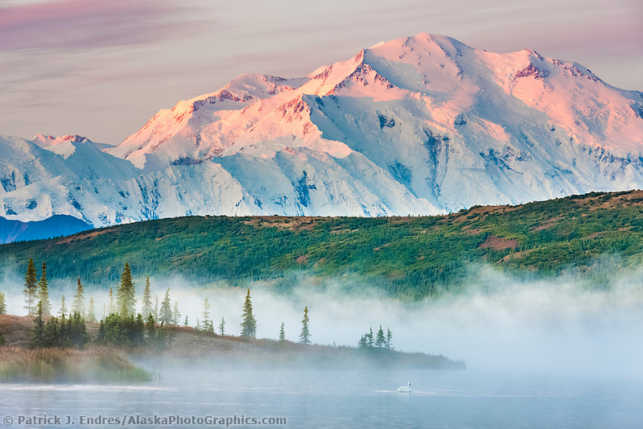
Coming back to Denali NP…..

Slide 9
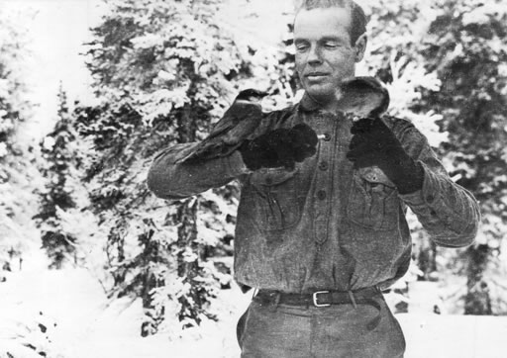
A self-made millionaire in the railroad business
Retired at age 36
Obsessively interested in the biology and taxonomy of mountain sheep
Explored extensively in Yukon and Alaska
Came to the north side of the Alaska Range to study Dall sheep
Personal friend of Teddy Roosevelt
To protect the rich variety of wildlife from extinction by market hunters, Sheldon proposed that the region be made a national park.
Charles Sheldon (1867-1928), zoologist and conservationist

Slide 10
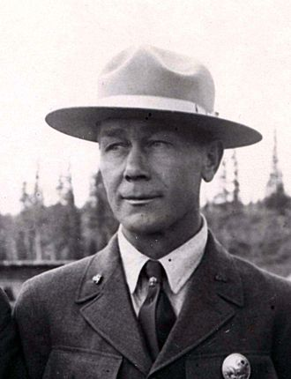
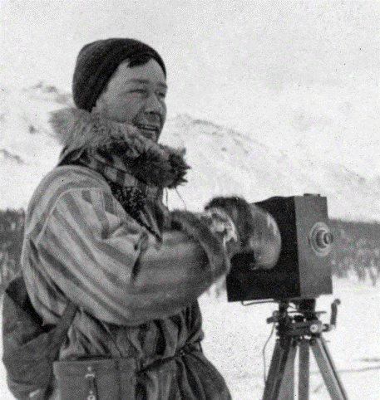
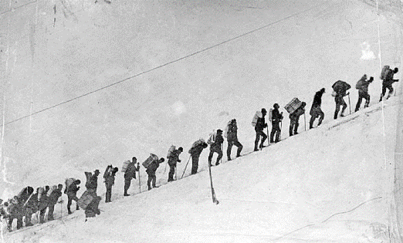
Sheldon hired Harry Karstens as an assistant one winter while working in what is now Denali NP
Harry Karstens (1878 –1955) began packing loads over Chilkoot Pass during the Klondike Gold Rush in 1897. He ended up as the first superintendent of Mount McKinley National Park

Slide 11
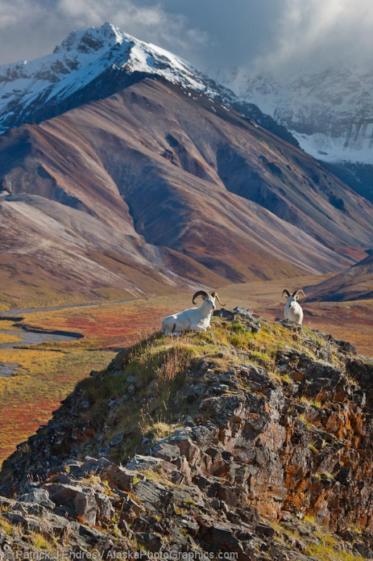
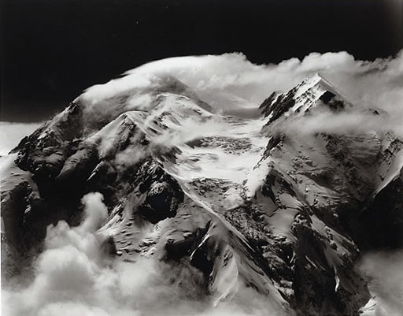
1917: Congress establishes Mount
McKinley National Park
as public park and game refuge
Mount McKinley, Mt. McKinley (later Denali) National Park, 1942, Bradford Washburn photograph

Slide 12
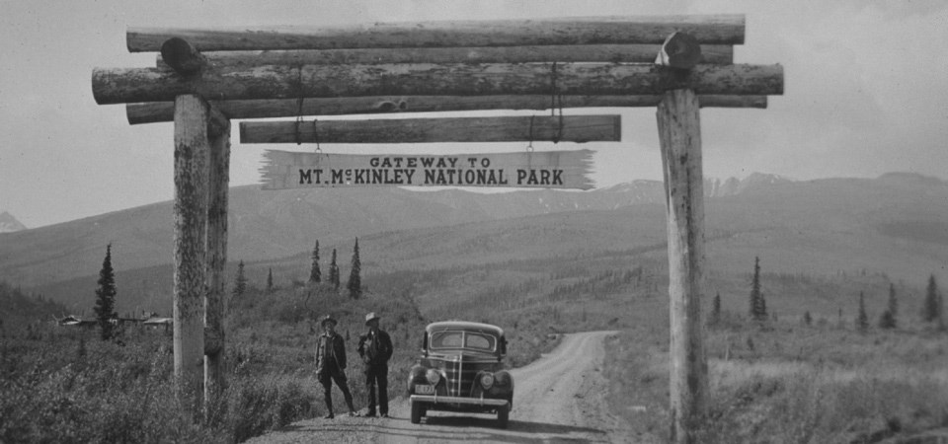
Construction of road to Wonder Lake on the north side of the Park began in 1923.
NPS Photo, Denali National Park and Preserve Museum Collection, DENA 23554.

Slide 13

1923-4: first concessioner in Denali NP: horse packing
newest concessioner in Park

Slide 14

1971
Alaska Native Claims Settlement Act
resolves long-standing issues re Native’s land claims in Alaska
80 million acres
transferred from State of Alaska
to Department of Interior
1980
after a lot of dithering in Washington DC, Alaska National Interest Lands Conservation Act (ANILCA) enacted

Slide 15
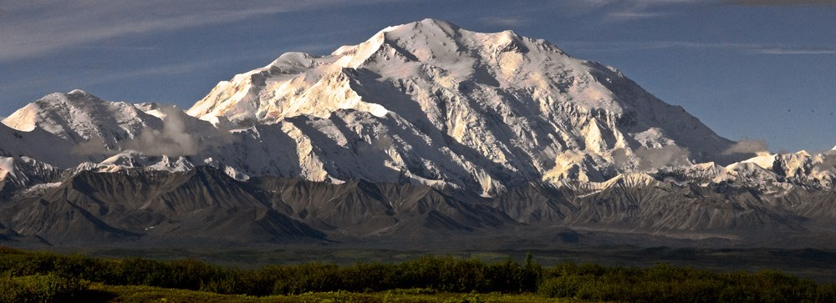
the Alaska National Interest Lands Conservation Act (ANILCA) established the Denali National Preserve and the Denali Wilderness.
NPS photo

Slide 16

NPS’ missions change as our cultural values change

Slide 17
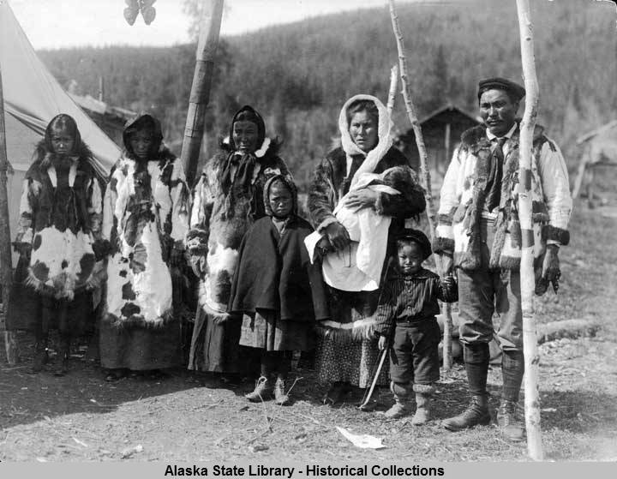
Naming the mountain
Koyukon Athabaskan people called the mountain Deenaalee (“the high one”)

Slide 18
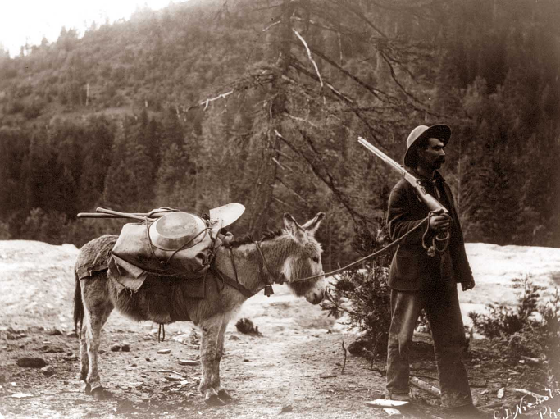
1889
Prospector Frank Densmore names it "Densmore's Mountain" after he approaches within 65 miles of the mountain.
https://frontierpartisans.com/13135/persistent-frontiers/

Slide 19
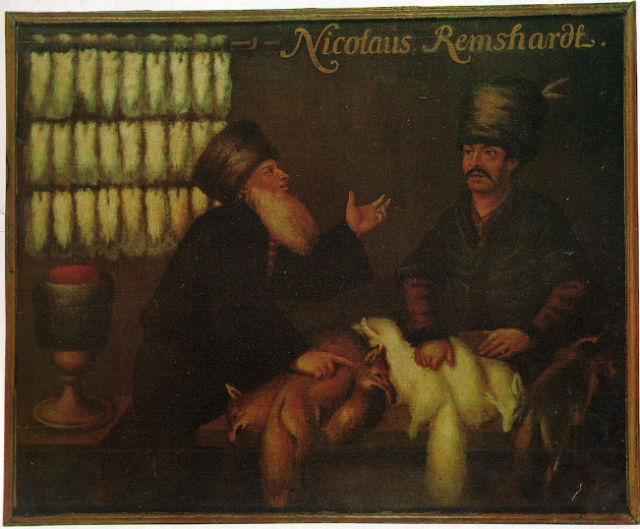
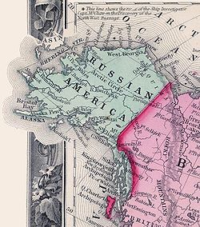
1780-1867: Russians refer to Denali as “Bolshaya Gora” (“big mountain”)
Aus Die Pelzmotte, 4/1968, 12. Jahrgang, Rifra-Verlag Murrhardt, S. 7., Public Domain, https://commons.wikimedia.org/w/index.php?curid=71645320

Slide 20
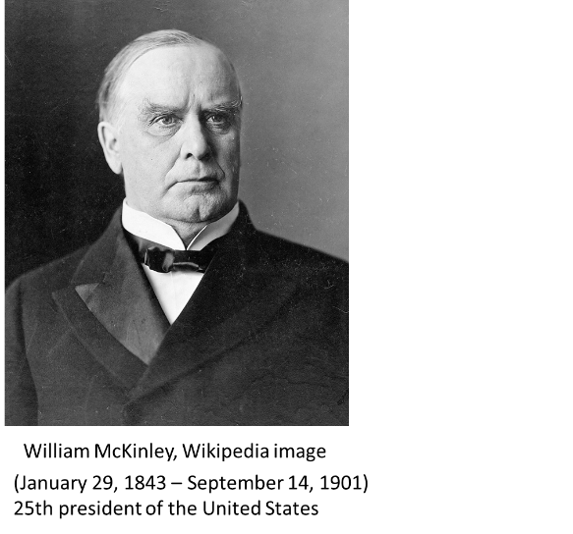
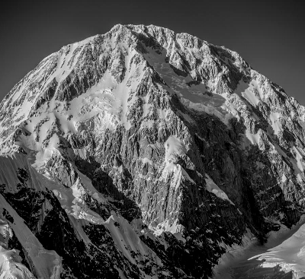
1896: mountain unofficially named Mount McKinley
by William Dickey, another gold prospector

Slide 21

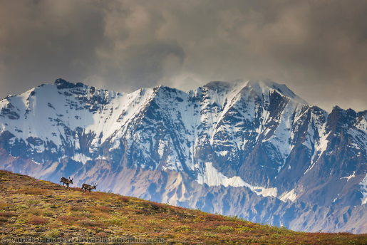
1917: mountain and park officially named “McKinley” by federal government
1917: Charles Sheldon wants both the mountain and park named “Denali National Park”

Slide 22
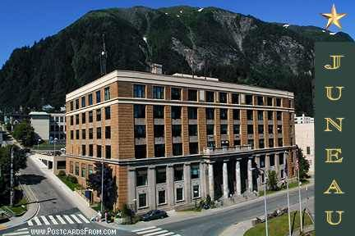
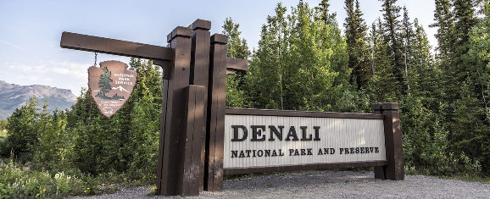
1975: Alaska legislature asks federal government to change name from Mount McKinley to Denali.
1980: Alaska National Interest Lands Conservation Act (ANILCA) changes the park’s name to Denali National Park and Preserve

Slide 23
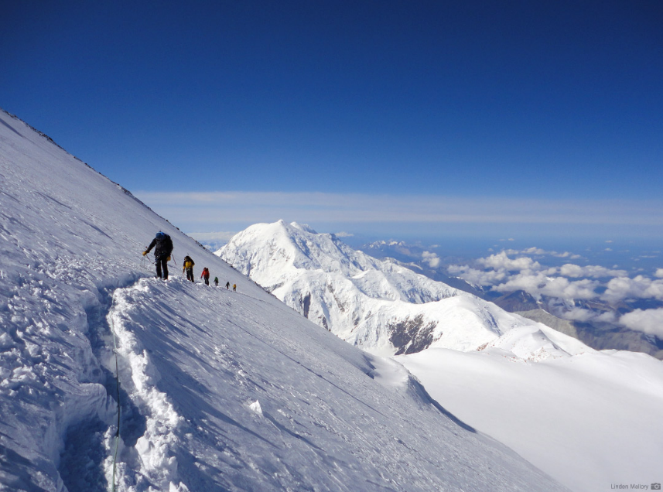
2015: President Obama restores name “Denali” to Mount McKinley
RMI photo

Slide 24
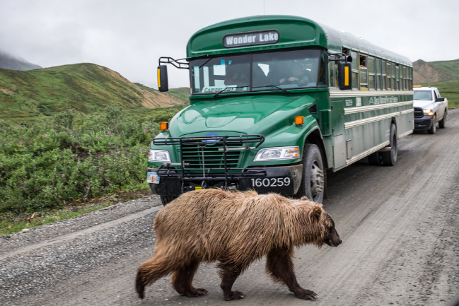
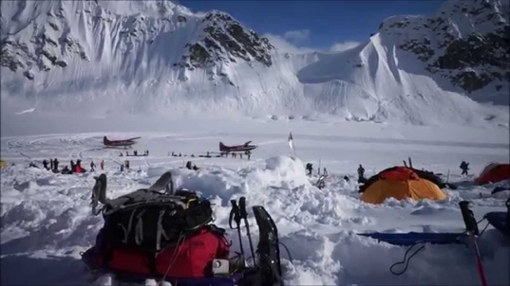
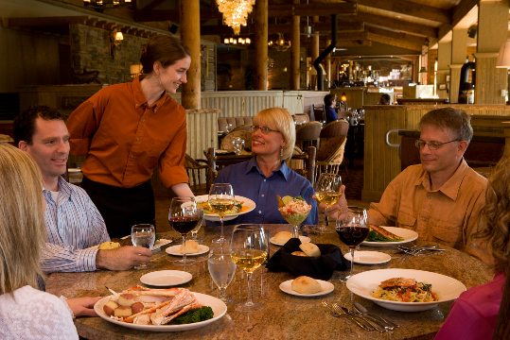
Denali National Park today

Slide 25
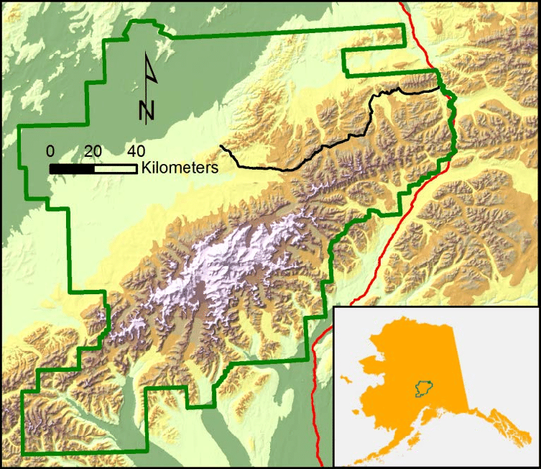
To Fairbanks
Park Headquarters
Wonder
Lake
the Park Road
D
Talkeetna

Slide 26
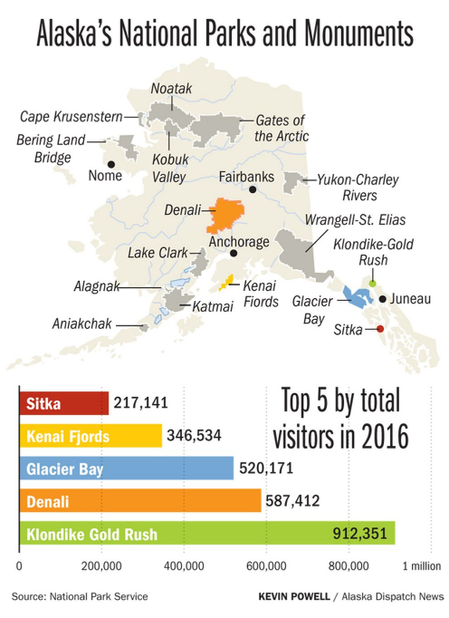
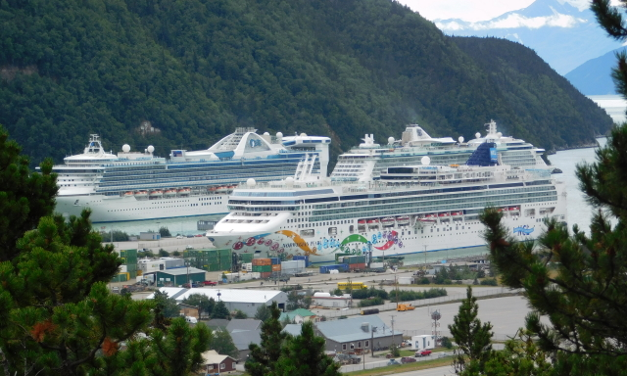
Denali ranks second in number of visitors only because no cruise ships can go there.

Slide 27
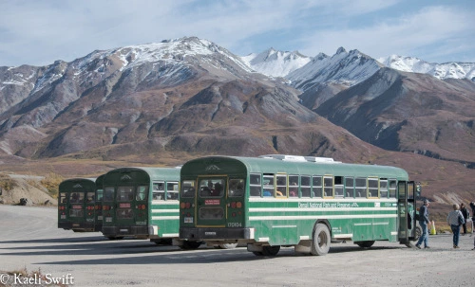
Most visitors to Denali ride a bus to Wonder Lake

Slide 28
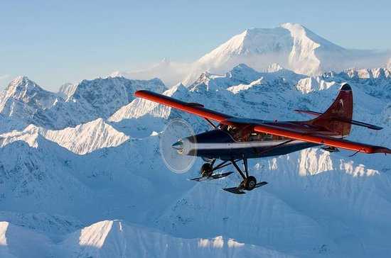
Some flight-see from Talkeetna.

Slide 29
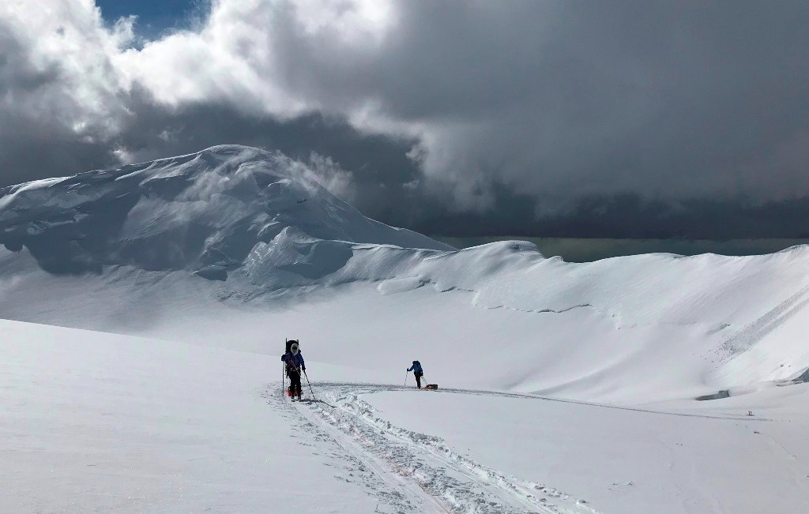
A tiny fraction of visitors to the Park
attempt to climb Denali (n=1114 in 2018)
NPS Photo (M. Coady)

Slide 30
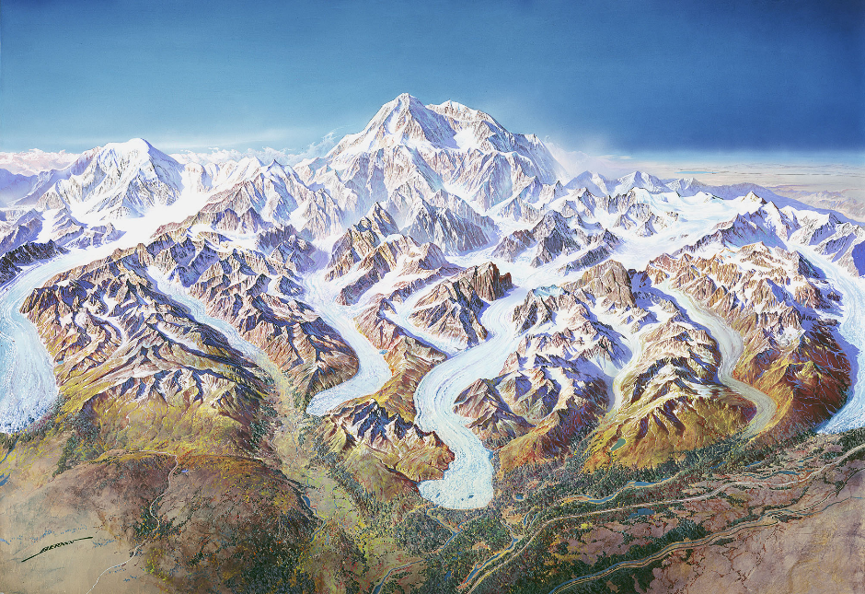
Climbing History
http://npmaps.com/wp-content/uploads/denali-panorama.jpg

Slide 31
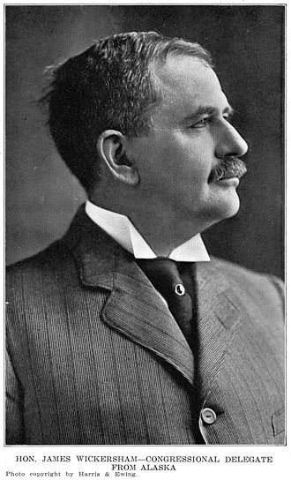
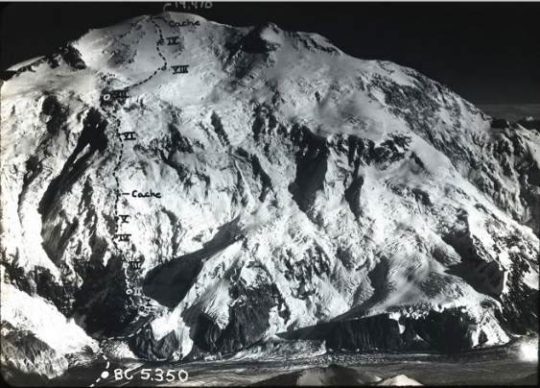
First known attempt
1903: Judge James Wickersham with 4 other men and 2 mules attempt the North Peak from Fairbanks.
They are defeated by floods, mosquitoes, and mud.
Wickersham Wall finally climbed in 1963

Slide 32
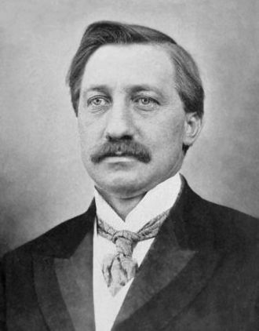
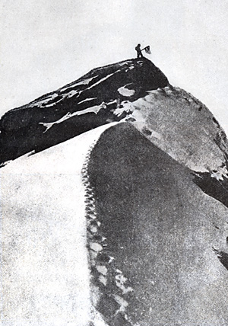
1906: Frederick Cook
physician, polar explorer, linguist….
and fake.
Cook claimed to have reached the North Pole a year prior to Peary and Henson.
He also claimed to have summited Denali in 1906.
Both claims were proven false.
(June 10, 1865 – August 5, 1940)
“Fake Peak”: Cook’s alleged summit photo on Denali

Slide 33
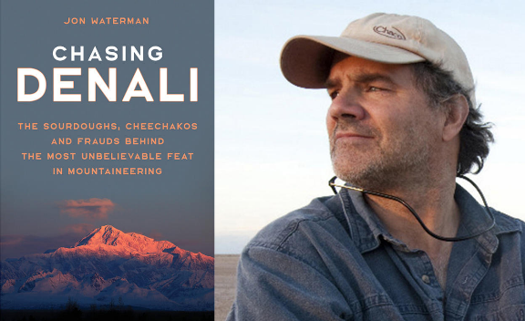
The Sourdough Expedition
Thomas Lloyd, Charles McGonogill, William Taylor, Peter Anderson
Left Fairbanks in February 1910 by dogsled.
Ascended Muldrow Glacier.
From there, un-roped, they supposedly climbed the North Peak and
planted a 14-foot spruce pole on top, which Archdeacon Stuck
thought he saw in 1913.
In a recent book, Jon Waterman
casts doubt whether the Sourdoughs
actually reached the summit of
the North Peak.

Slide 34
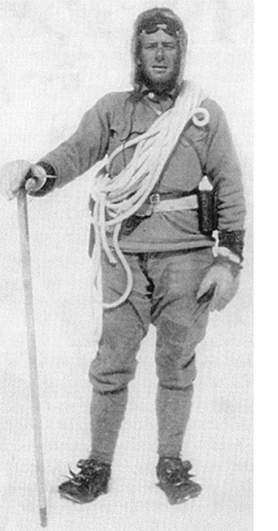
1912:
Belmore Browne and two others almost reach the summit.
They left from Susitna Station by dog sled in February.
Crossed the Alaska Range.
Begin their ascent of the Muldrow Glacier in late April.
Establish high camp at 16, 615 feet.
Make two summit attempts.
Turned back by high wind.
Belmore Browne
1880-1954
artist, explorer, mountaineer

Slide 35
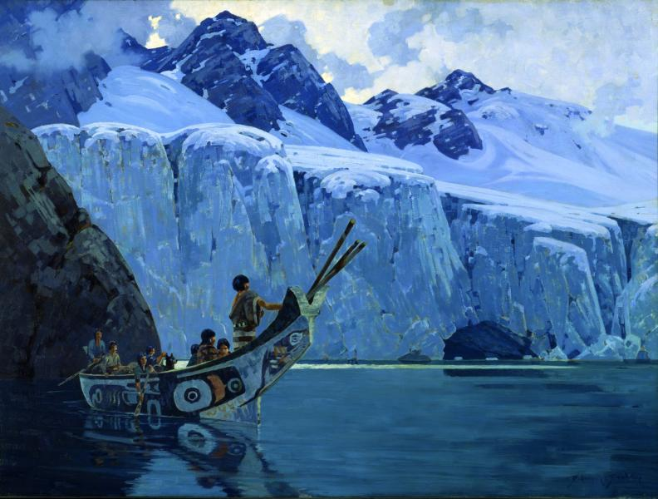
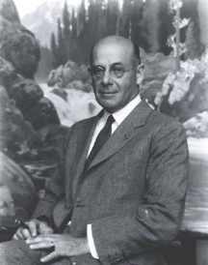
Belmore Browne is best known as a painter.
Much of his work was inspired by his wilderness trips to Alaska.
“The Chief’s Canoe” 1926, oil on canvas

Slide 36
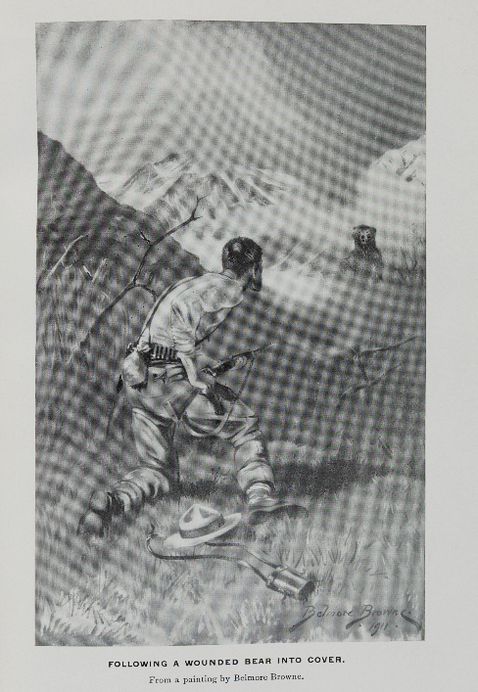
Early Denali expeditions required 3-4 months and involved numerous non-mountaineering skills.
BROWNE, Belmore (1880-1954). The Conquest of Mount McKinley: the Story of Three Expeditions through the Alaskan Wilderness to Mount McKinley, North America's Highest and Most Inaccessible Mountain. New York and London: G. P. Putnam's Sons, 1913.

Slide 37
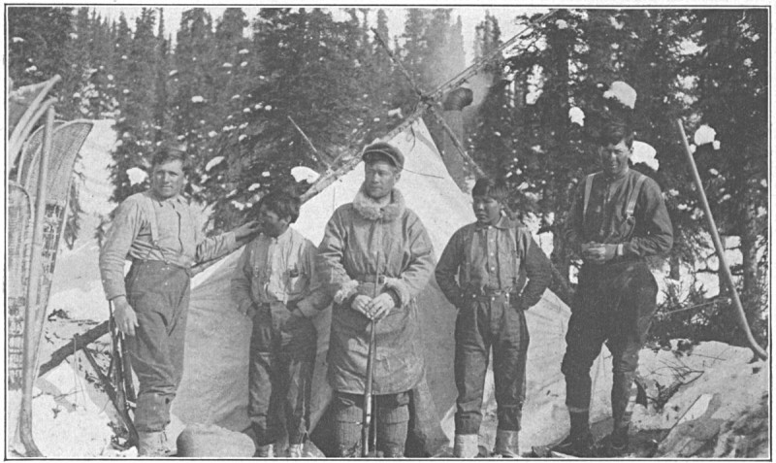
June 7, 1913: first ascent of Denali by
Hudson Stuck, Harry Karstens, Walter Harper, and Robert Tatum
The party was led by Hudson Struck (not pictured), Robert Tatum (possibly at left), Walter Harper (center), Harry Karstens (right), and two young Native Americans, Johnny and Esaias.

Slide 38
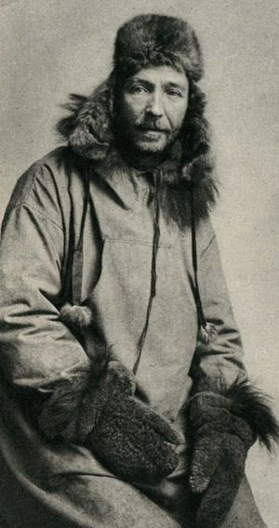
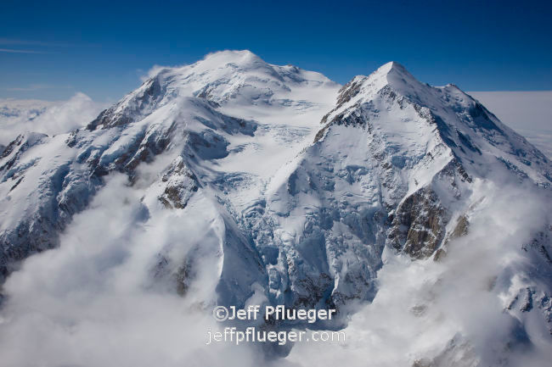
The expedition left Fairbanks in early April by dogsled.
Archdeacon Hudson Stuck: (1865-1920):
British-born missionary, social reformer, and mountain climber

Slide 39
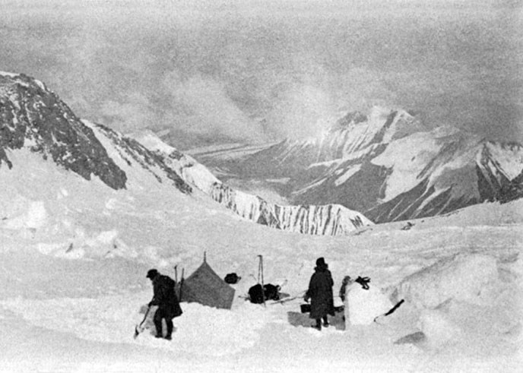
"Anyone who thinks that the climbing of Denali is a picnic is badly mistaken." -- Hudson Stuck
Grand Basin Camp 2
Project Gutenberg
17,500' in the Grand Basin between the North and South Peaks, 1913.

Slide 40
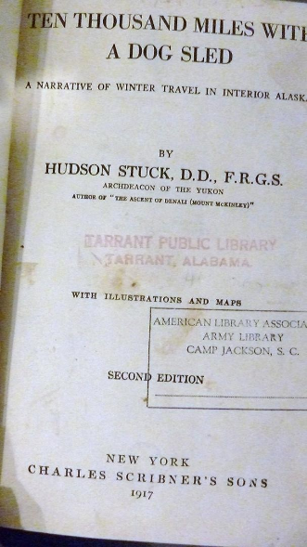
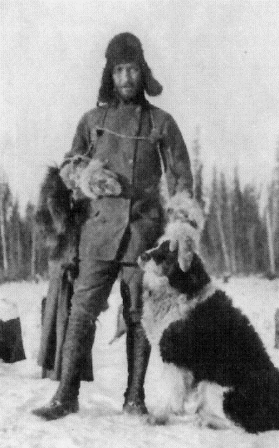
"Everything is okay when it's 50-below as long as everything is okay.“ -- Hudson Stuck

Slide 41


Walter Harper: Koyukon Athabaskan.
Born 1893. The first of the Stuck team to reach the summit.
Died in ship wreck on his way to medical school 1918
Harry Karstens
35 years old when he summited Denali in 1913.
First superintendent of Denali NP

Slide 42

WEST BUTTRESS
1951: First ascent by
Bradford Washburn and party

Slide 43


https://www.adventure-journal.com/2013/02/historical-badass-mountaineer-and-photographer-bradford-washburn/
©Bradford Washburn, courtesy DecaneasArchive.com
Bradford Washburn (June 7, 1910 – January 10, 2007)
American explorer, mountaineer, photographer, educator, and cartographer

Slide 44


Barbara Washburn:
first woman to climb Denali
June 6, 1947
Barbara Washburn (1914 –2014)

Slide 45

Bradford Washburn pioneered use of
large-format cameras from the open doors of aircraft.

Slide 46


First winter ascent: 1967 via the West Buttress
https://www.google.com/search?q=first+winter+ascent+of+denali&client=firefox-b-d&source=lnms&tbm=isch&sa=X&ved=0ahUKEwiK-dP3gK3hAhWGTX0KHddZB38Q_AUIDygC&biw=1280&bih=580#imgrc=JdxWq9gkLY6H3M:

Slide 47


1979
First dog team ascent by Susan Butcher, Joe Redington, Brian Okonek, Ray Genet and Robert Stapleton.
Susan Butcher (1954-2006)

Slide 48

DENALI MOUNTAINEERING TODAY
typical number of climbers attempting Denali each year is 1,300.
typical number of climbers reaching summit is 650
average success rate of around 50%.
10-14 rescues every year, and the mountain averages one fatality a year.
https://www.thoughtco.com/climbing-facts-about-denali-756089 (based on NPS statistics)

Slide 49
Summits by month in 2018
April: 2
May: 106
June: 353
July: 33
Busiest summit days
June 8: 67 summits
May 28: 47 summits
June 23: 40 summits
June 4: 37 summits
https://www.nps.gov/dena/planyourvisit/ams2018.htm

Slide 50
NPS Denali Climbing Statistics 2018
Climbers from the USA: 63% of total
Average trip length: 17 days; independent teams averaged a day less (16 days), while guided teams averaged a day more (18 days).
Average age: 38
Women climbers: 12% of total
https://www.nps.gov/dena/planyourvisit/ams2018.htm

Slide 51
Quiz time!
Who was the first woman to climb Denali? In what year?
Who led the first ascent of the South Peak of Denali in 1913?
Why did the Sourdough Expedition haul a 14-foot spruce pole to the top of the North Peak in 1910?
(HINT: Their expedition started from a saloon in Fairbanks)
4) Who was the first superintendent of Denali NP?
5) What US president was instrumental in founding Mount McKinley National Park in 1917?
6) Who was Charles Sheldon, and what was his role in founding the Park?
7) Give an example of how the mission of the National Park Service has changed in Denali NP as our
cultural values have shifted. (HINT: Do you hunt big game?)

Slide 52



8) What year was the West Buttress Route first climbed?
9) Name 2 artists who were leading climbers on Denali.
Walter Harper
Harry Karstens
The Archdeacon

Slide 53

THE END

